Slide 1




SQL PROJECT ON
PIZZA SALES

Slide 2

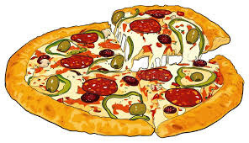
Hello!!
This is an SQL Project on Pizza Sales.
In this project, I have used various SQL queries to solve the problems related to the data: Pizza Sales.

Slide 3

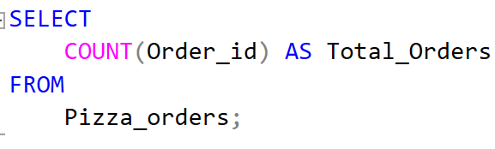

Query:
Retrieve the total number of orders placed.
Output:

Slide 4
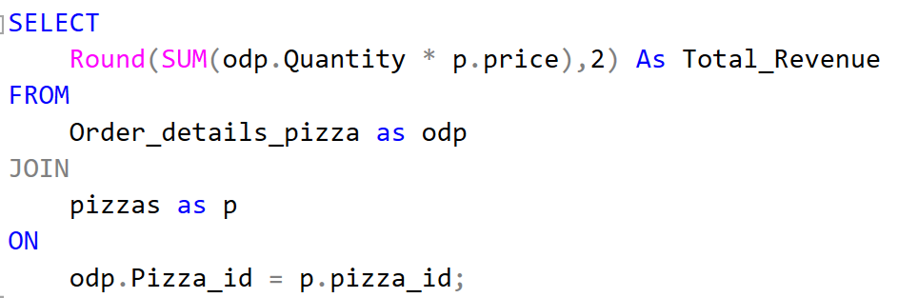

Query:
Calculate the total revenue generated from pizza sales.
Output:

Slide 5
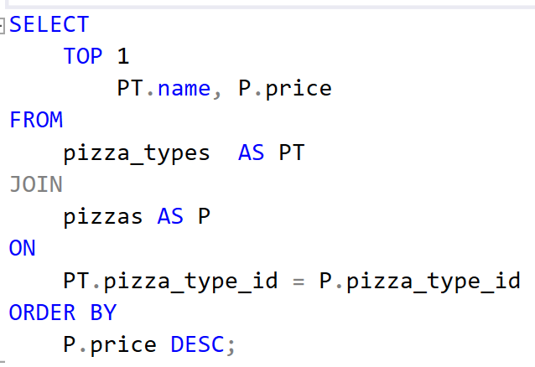

Query:
Identify the highest-priced pizza
Output:

Slide 6
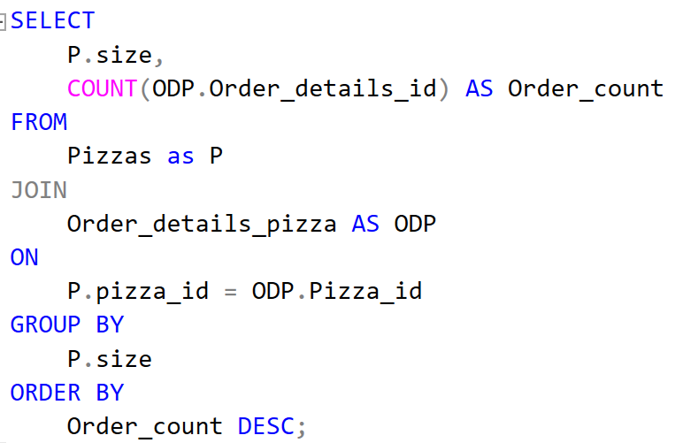
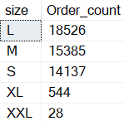
Query:
Identify the most common pizza size ordered.
Output:

Slide 7
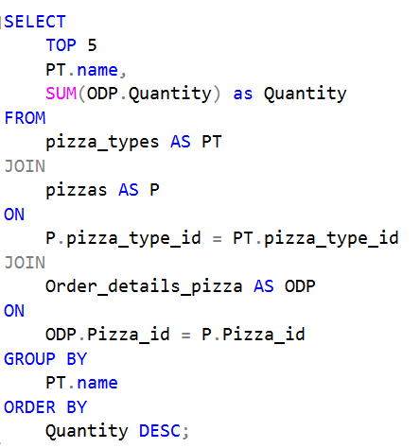
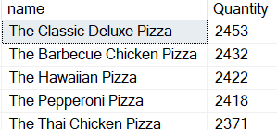
List the top 5 most ordered pizza types along with their quantities.
Query:
Output:

Slide 8
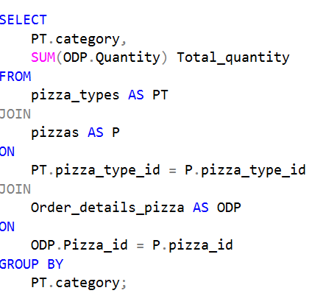
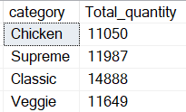
Join the necessary tables to find the total quantity of each pizza category ordered
Query:
Output:

Slide 9
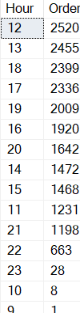
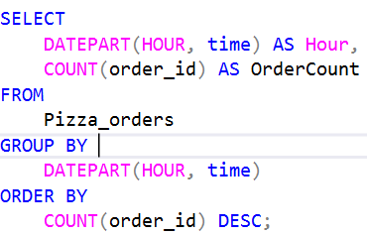
Determine the distribution of orders by hour of the day
Query:
Output:

Slide 10
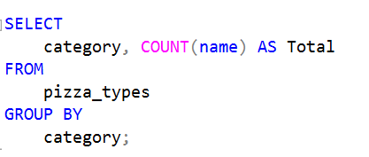
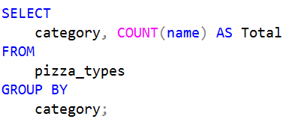
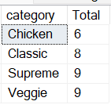
Join relevant tables to find the category-wise distribution of pizzas.
Query:
Output:

Slide 11
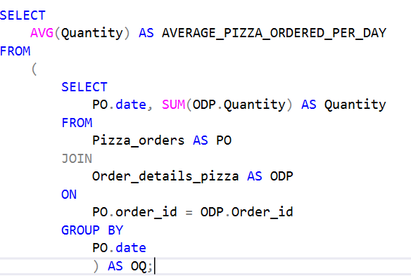


Group the orders by date and calculate the average number of pizzas ordered per day.
Query:
Output:

Slide 12
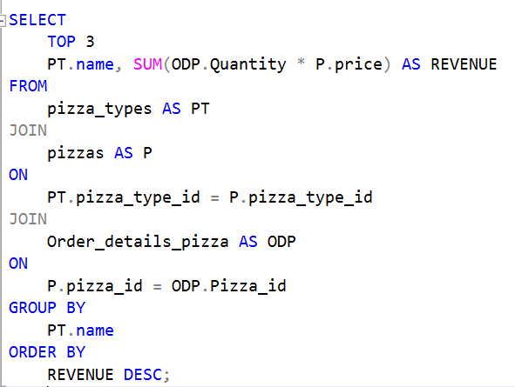

Query:
Determine the top 3 most ordered pizza types based on revenue.
Output:

Slide 13
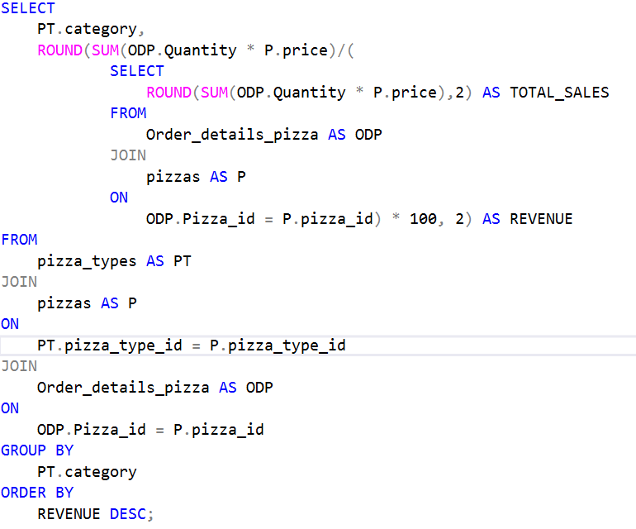
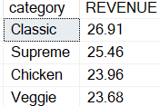
Query:
Calculate the percentage contribution of each pizza type to total revenue.
Output:

Slide 14
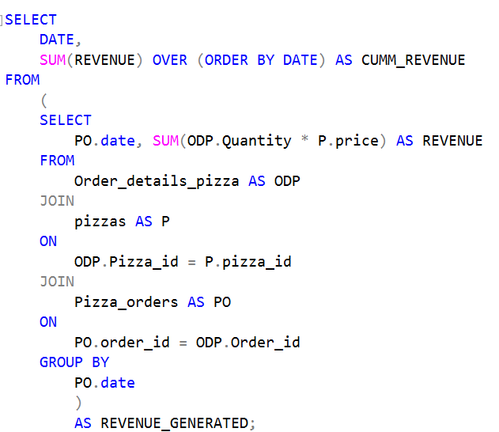
Query:
Analyze the cumulative revenue generated over time.

Slide 15
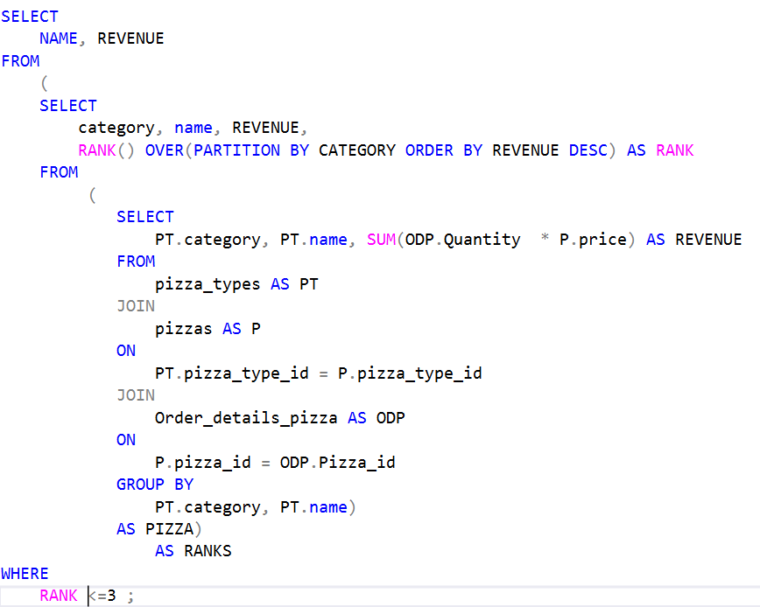
Determine the top 3 most ordered pizza types based on revenue for each pizza category.
Query:

Slide 16
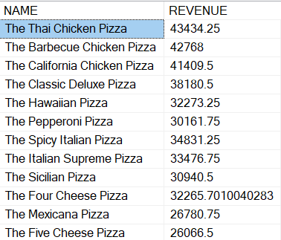
Determine the top 3 most ordered pizza types based on revenue for each pizza category.
Output:

Slide 17


